Slide 1
Cherokee County Lunch and Learn
Site Development Plans
February 27, 2020

Slide 2
This lunch and learn is designed to help the County and design professionals experience a quicker, more efficient site plan submittal process. We hope to reduce the number of submittals to review and approve a project. In this meeting you will be hearing from reviewers with common issues they see, as well as hear about additional information we will be providing as well as requiring.
In the future, we will be requesting a Project Information sheet be uploaded with all new site plan submittals. This document will ask for contact information for both the applicant and the developer so review comments can be shared with both. We will also be requiring that a complete set of plans be submitted for review. We have noticed that first submittals very rarely include all documents required for a complete review so we will list all items we will be looking for.

Slide 3
Development Inspections-Craig Henschel
Items regularly missing from submitted development plans are:
The project (PL) number on the cover sheet.
24-hour contact name and cell number on the cover sheet.
The names of all utility companies with contact information on the cover sheet.
Wetlands & State Waters note.
ACOE and EPD approval requirements note.
Endangered Species note.
Retaining walls note.
Fill materials and foundation inspection note.
As-built information requirements note for all non-residential and commercial project.
Stream buffers notes.
Clearing limits not to exceed 17 acres.
Temporary grassing every 7 days.
No grading within the undisturbed stream buffers or zoning buffers.
Use silt fence along the curb to prevent sediment from entering the street.
Sidewalks size and location note.
Sidewalk requirement per zoning district.
Parking space and parking lot dimensions.
NOI requirement.

Slide 4
Planning and Zoning Department-Thomas Trawick
What to submit:
  Cover Page
    Vicinity/Location map, contact information, name of plan, registered seal, zoning (including overlay), TIN/PIN, dates of plans, project narrative, setbacks, parking calculations, site characteristics, greenspace, etc.
  Zoning/SUP Resolutions and Variance Letters
  Neighborhood/Illustrative Plan – if in Bells Ferry Overlay or TND (Articles 8 and 16)
  Lighting Plan (Article 25)
    Photometric plans, manufacturing catalogs for fixtures, elevations for aiming angles and mounting height, etc.
  Landscape Plan
    Buffers, streetscape requirements (BFO/TND, Hwy 92, or landscape strips)
  Use conditions (Article 7 or Zoning Resolution)
  Parking calculations (Article 12)
  Private Streets (Article 5) - BOC
  Conservation Easements (Article 23) - BOC
  Protective Covenants
Separate Reviews
  Signage (Article 11)
  Amenities (Article 7)

Slide 5
Fire Marshal-Commercial Sites
Frequently overlooked items
Current code and editions with state amendments. Include local ordinances.
  2018 International Fire Code- Local Adoption of Appendix B, C and D.
  2018 NFPA 101 Life Safety Code
  2020 State Amendments (can be found on DCA website)
  Any relevant NFPA Standards can be found in the State Amendments
  Cherokee County Code of Ordinances- Chapter 28- Fire Prevention and Protection
Fire Hydrants
  Water flow test results.
  Compliance with Appendix B and C of the IFC for fire main and hydrant distribution
  FDC, PIV, DDC location
Fire Department Access
  Electronic gates must have Knox Gate Key Switch
  Appendix D of the IFC for fire department access
  Building height
IFC Section 510- Emergency Responder Communications System

Slide 6
Fire Marshal
As-Built Requirements
  Fire Hydrant GPS locations in State Plane coordinates
  Water flow results for all fire hydrants- Static, Residual and Flow (GPM)
    Include all water flow data in attributes table

Slide 7
Fire Marshal-Residential Sites
Frequently overlooked items
Current code and editions with state amendments; include local ordinances.
  2018 International Fire Code- Local Adoption of Appendix B, C and D.
  2018 NFPA 101 Life Safety Code
  2020 State Amendments (can be found on DCA website)
  Any relevant NFPA Standards can be found in the State Amendments
  Cherokee County Code of Ordinances- Chapter 28- Fire Prevention and Protection
Fire Hydrants
  Water flow test results.
  Compliance with Appendix B and C of the IFC for fire main and hydrant distribution
  Fire Hydrants must be located within the 1st 200 of the entrance, all intersection and the end of cul-de- sacs.
All Site work needs a pre-construction meeting

Slide 8
Fire Marshal
Final Plat
  All fire hydrants and lot information on one page
    Fire Hydrant GPS locations in State Plane coordinates
    Water flow results for all fire hydrants- Static, Residual and Flow (GPM)
    Include all water flow data attributes table
Phases
    Temporary turnarounds, cul-de-sacs, etc
How the FMO approves final plat submittals
    Review of final plat
    Field inspection of as-built conditions
    Approval of final plat

Slide 9
Arborist-Shannon Fitzgerald
Tree Preservation and Replacement Plan
Arborist Report
If your project requires an LDP, a Tree Preservation and Replacement Plan is required

Slide 10
Soil/Water Conservation- Joe Bishop
GSWCC checklist to be submitted as a separate document

Slide 11
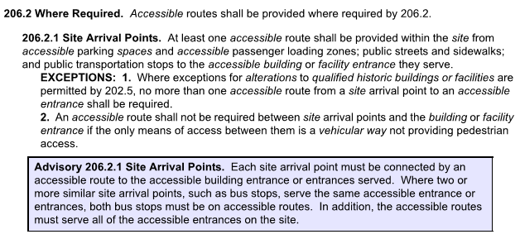
Building Department- Jim Haizlip
Accessible Routes

Slide 12

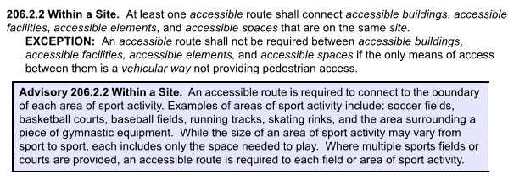

Slide 13
Parking Spaces
Show ADA accessibility details for parking spaces, signage, ramps, handrails, guardrails, etc. per in compliance with 2010 ADA Standards w/ GA. Accessibility Standards 120-3-20.
Slopes for Parking spaces not steeper than 1: 48 (2%) shall be permitted ADA 502.4.
Show ADA parking space details. Every parking lot should have a minimum of one van accessible space. Van spaces require 96” wide aisles where the parking space 96” wide. A 60” wide aisle can be used if the parking space is 11 feet wide, in compliance with ADA 502.
Parking lot marking and signage plan. The van accessible ADA space signs and car space signs must be mounted a minimum of 5 feet above ground surface measured to the bottom of the sign. Access aisles shall be marked to discourage parking in these areas, in compliance with ADA 502.

Slide 14
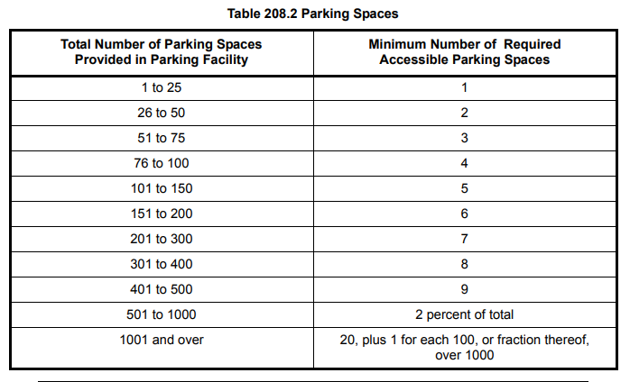

Slide 15
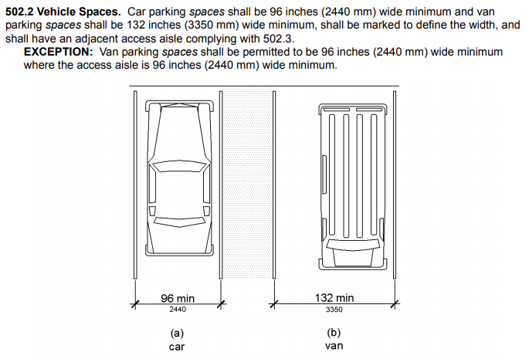

Slide 16
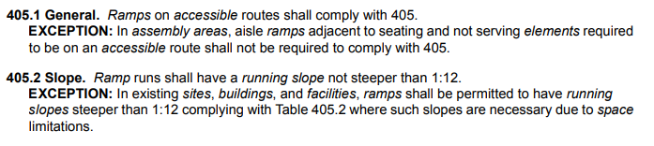
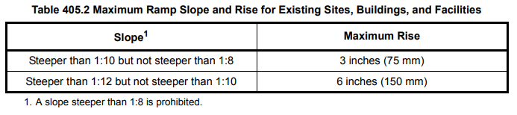

Ramps

Slide 17
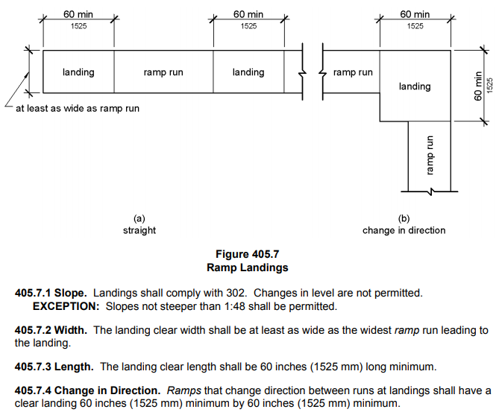

Slide 18
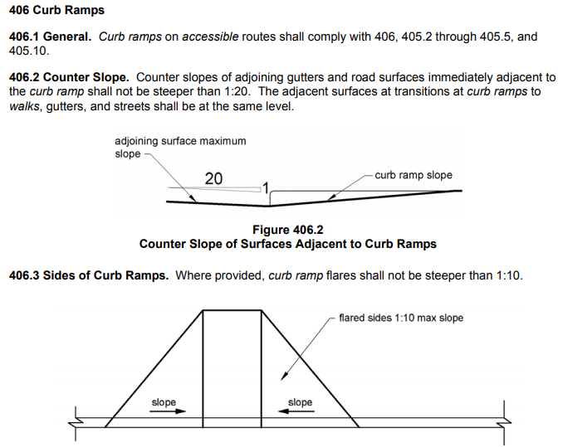

Slide 19
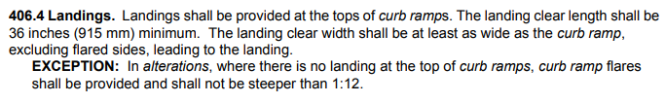
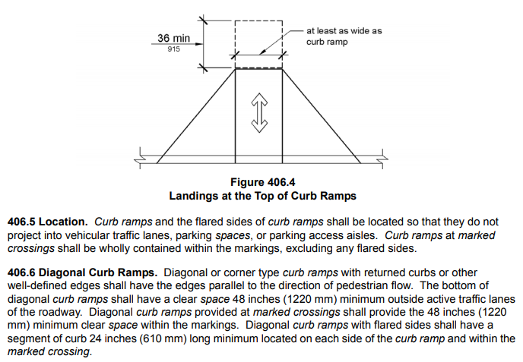

Slide 20
Cluster Mailboxes for Subdivisions
Include at least one Van accessible ADA parking space and adjoining access isle with the proper signage, slope of pavement and striping in compliance with ADA 403 & 502.
An accessible route from the accessible parking area to the cluster mailboxes should be included in the design in compliance with ADA 403.
Total number of parking spaces for Cluster Mailboxes per size of sub-division should be designed to meet the requirements of the Cherokee County Engineering Dept.
If a roof structure will be constructed to cover the Cluster Mailboxes, architectural drawings with structural details will be required to be submitted through the Cherokee County Development Service Center.

Slide 21
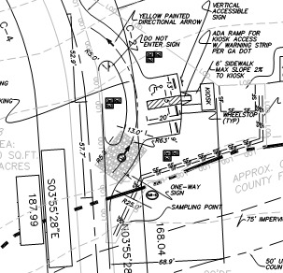
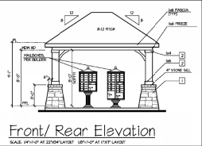

Slide 22
Buildings Encroaching on
Retaining Wall Separation Distance
Regarding proposed buildings encroaching the required separation distance to adjacent site retaining walls, prior to the issuance of the building permit; (1) Walls must be completed and a Letter of Completion must be submitted (LOC) by a Georgia registered engineer, (2) Building permit applicant must provide an engineered foundation design / analysis, prepared by a licensed professional engineer, complying with the State of Georgia requirements.

Slide 23
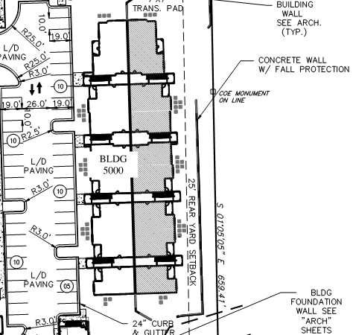

Slide 24
Transportation-Carson Jones & Brett Buchanan
If a GDOT permit is required, get started early. We want their approval prior to issuance of the LDP.
If something is not covered in the Development Regulations, we will follow AASHTO, ADA, and/or GDOT design standards.
Comments are usually site specific, use the Transportation Checklist to QA/QC your work prior to submittal.

Slide 25
Stormwater Management Plan – Significant Components - Ben Morgan
The Cherokee County Stormwater Division fielded 307 complaints in 2019. To Date in 2020, we have fielded 99 complaints. A majority of these complaints can be tied to “THE BIG THREE”.
  Downstream
  Offsite
  Bypass

Slide 26
Downstream
Problems downstream are by far the most costly to a construction project. These can result in delays in construction, final plats, certificate of occupancies, and have the potential for lawsuits.
The analysis of downstream conditions in the report shall address each and every point or area along the project site’s boundaries at which runoff will exit the property. The downstream analysis shall also include a thorough review of immediate downstream nodal components (pipes, channels, etc.). Upsizing of undersized pipes or stormwater channels may be required where applicable based on downstream analysis. Care shall be taken to minimize impact to downstream properties.
Protect your clients!

Slide 27
Documentation required in report
  Photos/documentation of existing conditions
  Review of downstream pipes and channels for functionality
  Identify potential complaints
  Peak flow and velocity reduction
  100 year ponding analysis
Drainage Easement
  Consider stormwater a utility, the same as water and sewer
  Where will you discharge?

Slide 28
Offsite
Identify all offsite drainage basins
Recommended to bypass around proposed project to reduce stormwater facility sizes
Channels, pipes, and inlets required to safely convey around proposed structures, not between/along property lines
  Channels 25-year plus 20% freeboard minimum
  Pipes – 100 year capacity
  Inlet Control Capacity – 100 year with 1-foot freeboard for structures

Slide 29
Bypass
Minimize bypass from your project – ties in with downstream component.
Lot Drainage Constructability
  Per Section R401.3 of the 2012 International Residential Code, the entire lot shall be graded to drain surface water away from all foundation walls. The grade shall fall a minimum of 6 inches within the first 10 feet. Where lot lines or other physical barriers prohibit 6 inches of fall within 10 feet, the final grade shall slope away from the foundation at a minimum slope of 5 percent and the water shall be directed to drains or swales to ensure drainage away from the structure. Swales shall be sloped at a minimum of 2 percent.
  Splits lot drainage is standard
  Attempts at forcing drainage from rear of lots to front/curbs have been unsuccessful
  Lots are deeper, not wider
  Lot grading plan requirements
  Frustration on building permit and certificate of occupancy side
  12” piping with 10 foot drainage easement (private)

Slide 30
Stormwater Management Plan – Significant Components-Ben Morgan
Basin Maps
  Existing
  Proposed
  Downstream &10% analysis
  Water Quality Basin Maps
    On-site only. This should be included on construction plans
      Provides clear direction to contractors and inspectors on drainage basins

Slide 31
Water Quality
  Water Quality Basin Map that Matches Site Review Spreadsheet
  Minimum 10 acres for micropools
  Combination extended dry detention and infiltration trench – soils testing where BMP is being placed
  Sand filters not allowed in residential subdivisions per GSWMM
  Bioretention Areas
  Proprietary Devices
    Provide direct comparison/supporting calculations for WQv to flowrate for proprietary device. What many consultants do is generate a hydrograph where the precipitation is 1.2” of rainfall, and utilize the on-site area and associated curve number to generate the flowrate. This is then used to select the diameter of the structure based on the manufacturer’s flowrate specifications.

Slide 32
Water Quality
  Proprietary Devices
    Not allowed in right-of-way
    Third party testing data always required
  Utilize stream buffers, floodplain, and zoning buffers as natural conservation area, reduces volume requirements in ponds.

Slide 33
Facility Details
  Cherokee County requires Operation & Maintenance details for end user (HOA, Commercial Management Companies)
    Engineer & Developer's Involvement minimal in long-term life cycle
  The GSWMM website has digital design details in AutoCAD format that can be easily manipulated for your project: https://atlantaregional.org/natural-resources/water/georgia-stormwater-management-manual/

Slide 34
Pipe Material
  Reinforced concrete pipe is required under roads and parallel to right-of-way; HDPE or CMP is only allowed in the right-of-way on a perpendicular (or near) crossing outside the roadbed. RCP shall be used for pipes within the structural zone of influence of the curb, subgrade, sidewalk, GAB, etc.
  For lots less than 10,000 square feet 12” HDPE or 12” CMP may be used to serve a single lot. A 10 foot wide drainage easement is required. A metal dome inlet or standard GDOT pedestal inlet must be provided. Junction boxes are required at County right-of-way if this is utilized. Profiles and a pipe chart must be provided for this conveyance.

Slide 35
Multiple Resources Readily Available:
  GDOT Details
  Cherokee County GIS
    Floodplain, Pipes, Ponds, Topography, etc.
  Checklists Online
  Development Regulations Online
  Georgia Stormwater Management Manual Website

Slide 36
Questions or comments

